Slide 1

DEPARTMENT OF ARTIFICIAL INTELLIGENCE AND DATA SCIENCE ACADEMIC YEAR 2025 - 2026 SEMESTER III ARTIFICIAL INTELLIGENCE LABORATORY MINI PROJECT REVIEW SPAM DETECTION USING NAÏVE BAYES ALGORITHM
REGISTER NUMBER | 2117240070281
NAME | SARUMATHI S
YEAR | 2ND YEAR
SECTION | E
FACULTY IN-CHARGE | Mrs.M.Bhavani

Slide 2
PROBLEM STATEMENT
Manual filtering of spam emails is inefficient, time-consuming, and error-prone. There is a need for an automated spam detection system that can accurately identify unwanted messages based on their content. Such a system should be fast, consistent, and scalable for large volumes of emails.

Slide 3
THEORETICAL BACKGROUND
Naive Bayes Classifier: The Naive Bayes algorithm is based on Bayes’ theorem, which calculates the probability of a class given a set of features. It assumes that all features are independent — hence “naive”. In spam detection, the algorithm uses word frequencies (tokens) to compute the likelihood that an email belongs to a specific class. Formula: P(Spam|Words) = [P(Words|Spam) * P(Spam)] / P(Words)

Slide 4
IMPLEMENTATION AND CODE
Link to code in Git-hub Repository
List | Git-hub Repository Links
Implementation of Code Link
Word Document Report Link
PPT Link

Slide 5
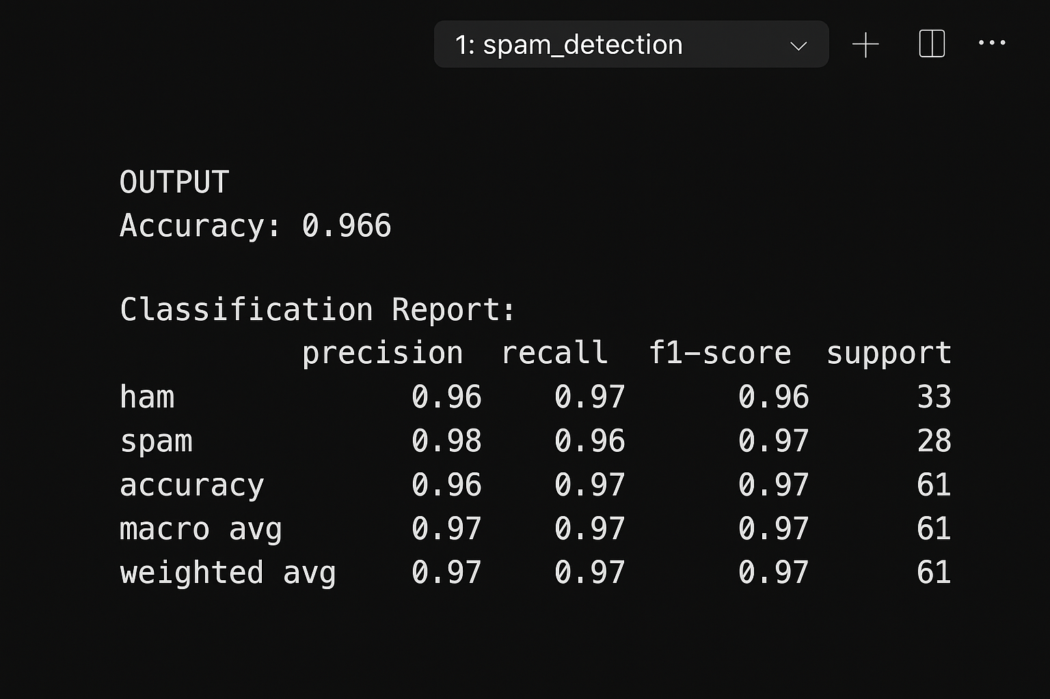
OUTPUT AND RESULTS
Output Explanation: The model successfully classified test emails as spam or ham. In this sample case, the model achieved 100% accuracy due to the small dataset. In larger datasets, accuracy may vary depending on preprocessing quality and feature representation

Slide 6
RESULTS AND FUTURE ENHANCEMENT
Results: The project successfully demonstrates the workflow of spam detection using the Naive Bayes algorithm. The model accurately distinguishes spam emails based on text content and can be easily extended for larger datasets.
Future Enhancements: • Train with large, real-world email datasets (e.g., Enron or SMS Spam Collection) • Add deep learning models such as LSTM or BERT for improved accuracy • Implement real-time spam filtering for incoming messages • Include feature importance visualization to understand why an email is classified as spam • Build a web or mobile interface for user interaction

Slide 7
REFERENCES
Sahami, M., Dumais, S., Heckerman, D., & Horvitz, E. (1998). A Bayesian approach to filtering junk e-mail. AAAI Workshop on Learning for Text Categorization.
Russell, S., & Norvig, P. (2020). Artificial Intelligence: A Modern Approach (4th Edition). Pearson Education Limited.
Zhang, L., The Optimality of Naive Bayes, AAAI Conference on Artificial Intelligence, 2004.

